Slide 1
Introduction to Eclipse
Integrated Development Environment (IDE)

Slide 2
What is Eclipse?
Eclipse is an Integrated Development Environment (IDE)
IDE’s are software applications designed to help programmers develop software
Software used to be written with just a text editor and command line tools
Products such as Eclipse integrate this functionality and add many more useful features

Slide 3
Eclipse IDE - Overview
Originally built by IBM – free to download
Supports Java programming out of the box
Written in Java (so platform independent)
Supports a “plug-in” philosophy (1000’s of plugins are available)
Complex to learn, but a real professional IDE
Very common platform within industry

Slide 4
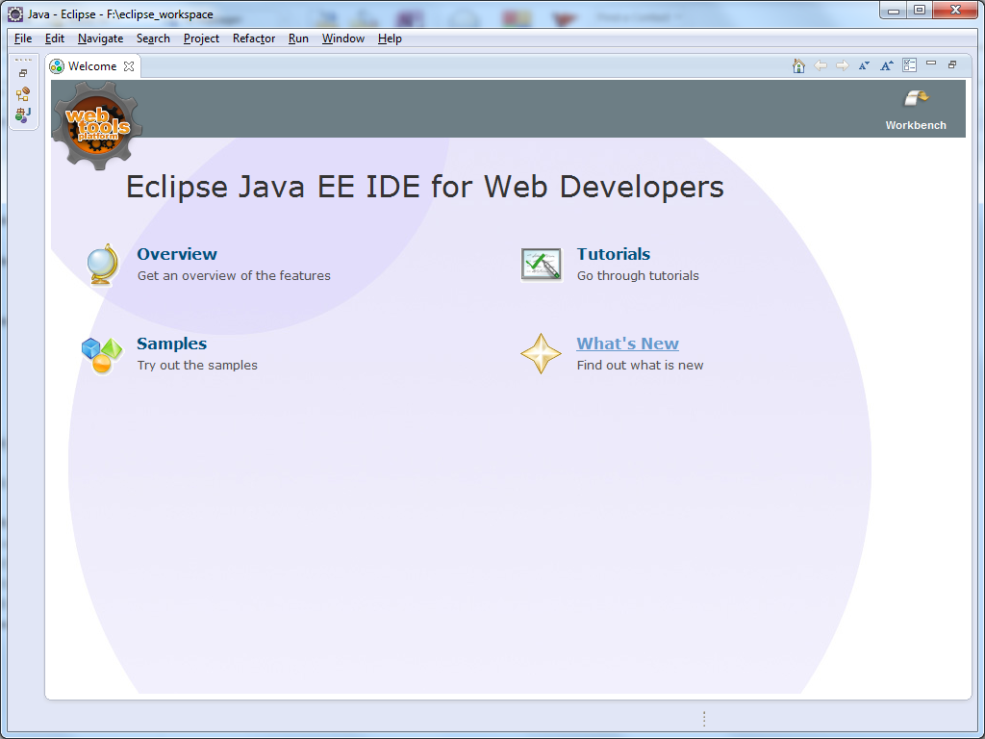
Getting started - click “workbench” to begin

Slide 5
The Workbench
Eclipse uses a workbench metaphor, and shows a number of development tools within windows
Developers tend to mostly use the central text editor
However the Project explorer window needs to be also used to manage projects etc.
Important note: Tools windows, menu options etc. can move around!

Slide 6
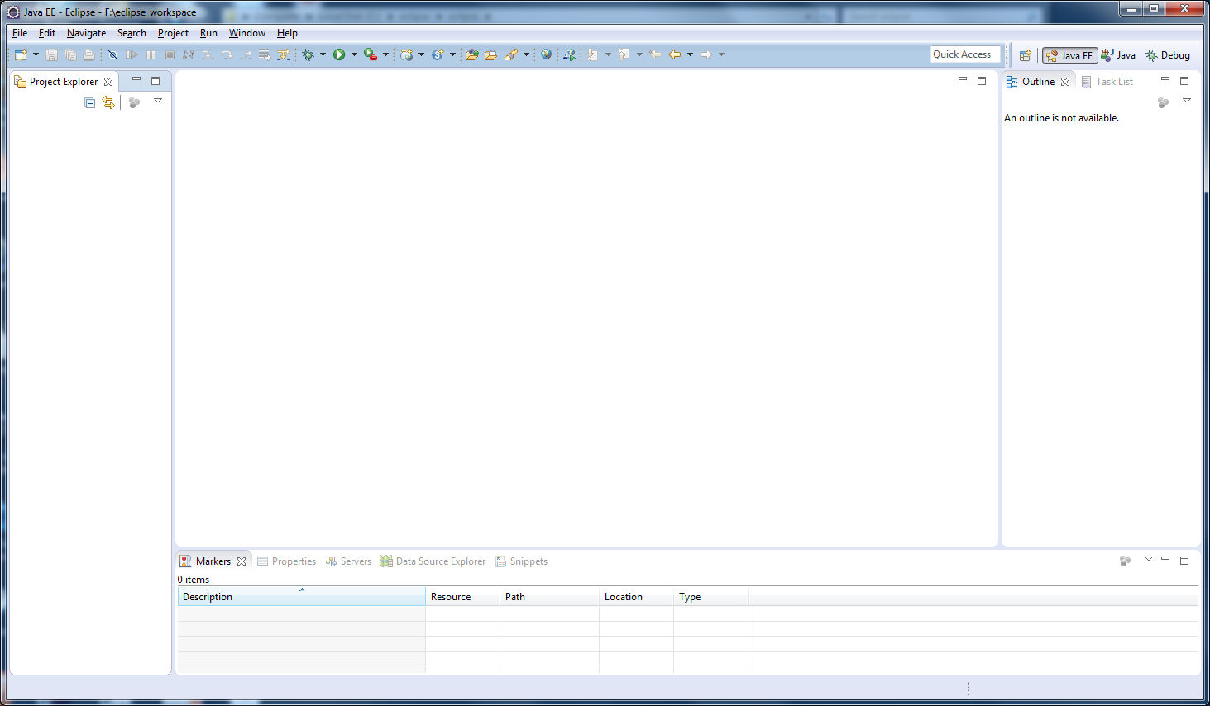
The workbench
Project/Package Explorer
Text Editor Tool

Slide 7
Creating a new project
Since Eclipse is made for “professionals” it expects you to know what to do!
All projects stored in a workspace. The first time you run Eclipse this should default to f:/eclipse_workspace
To create a new Java project select
File | New -> Java Project
Note: sometimes you may have to go via the “Other” menu to find “Java Project” (see next slides)
Enter a project name, e.g. “HelloWorld”, accept the default options and press “Finish”

Slide 8
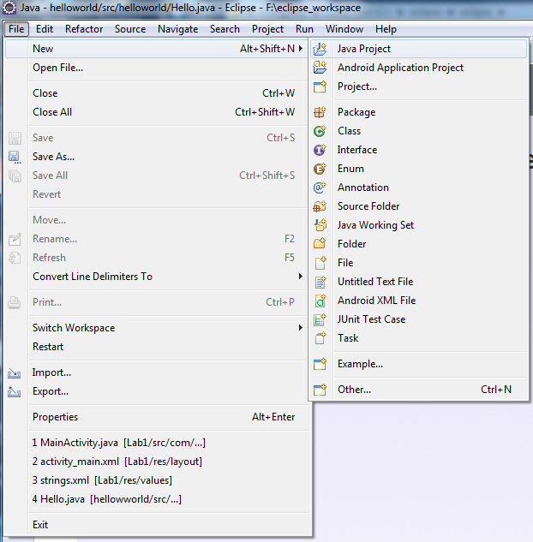
Creating a new Java Project (easy way)
File | New
Java Project

Slide 9
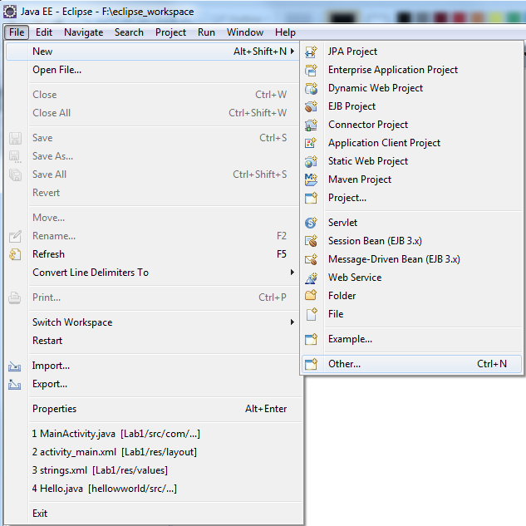
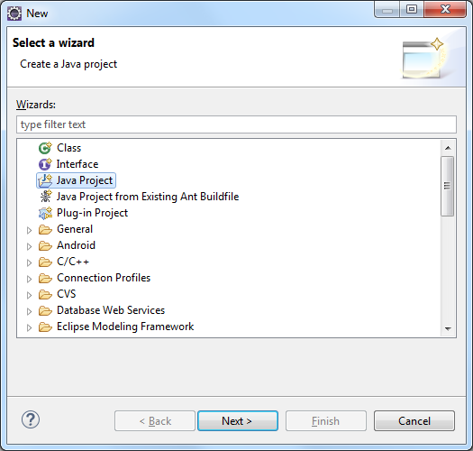
Creating a new Java Project (via “Other”)
Select Java Project
Then press Next

Slide 10
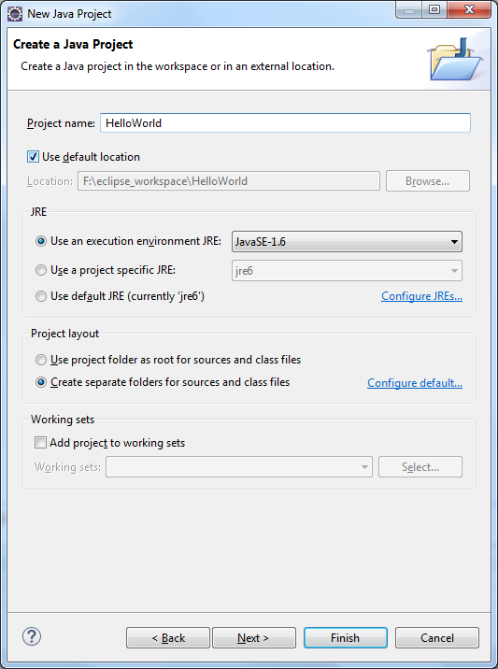
Project Name
Select “Finish” to accept defaults

Slide 11
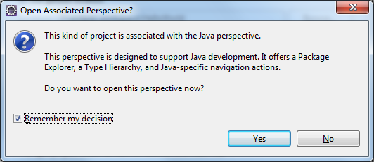
Sometimes… you may see a dialogue box
Tick “Remember my decision” to prevent this from showing each time, followed by “Yes”.

Slide 12
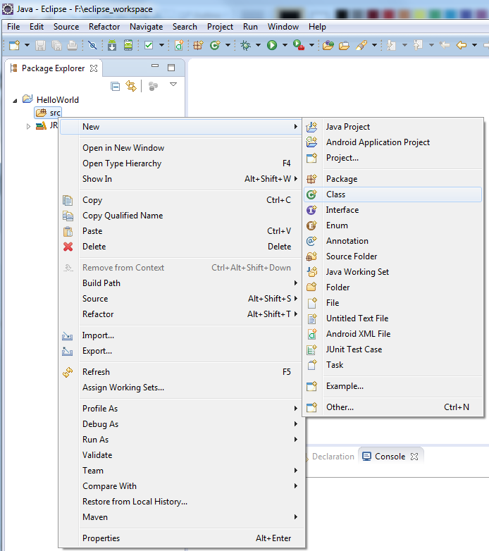
Writing and running code
Start by adding a new “class”
Right click on helloworld/src within the “Package Explorer” view
Select “New -> Class”
Enter a class name, e.g. “Test”, then press “Finish”.

Slide 13
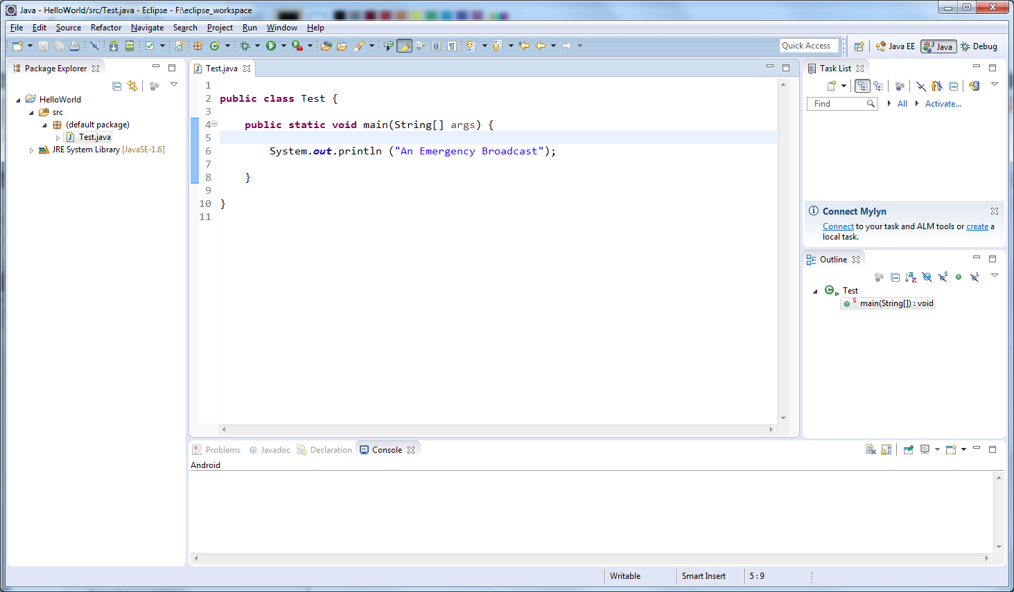
Use the Editor to write some code

Slide 14
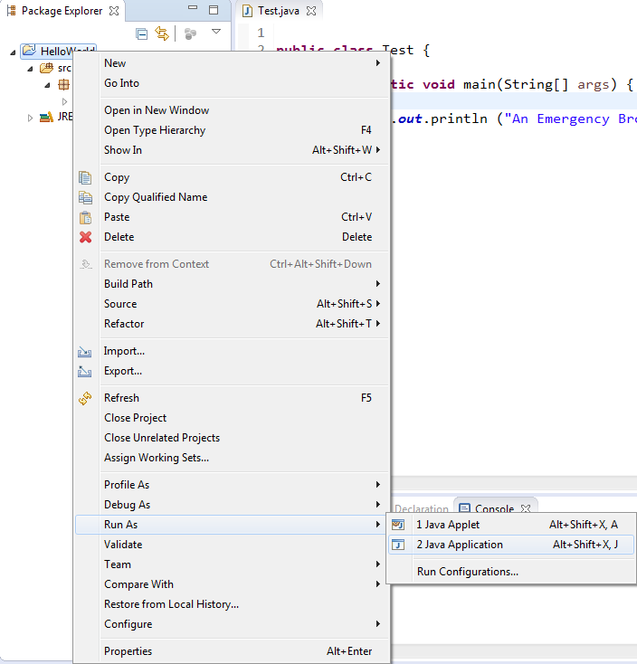
To Run the code – Right click on the project
Select “Run As” then select
“Java Application”

Slide 15
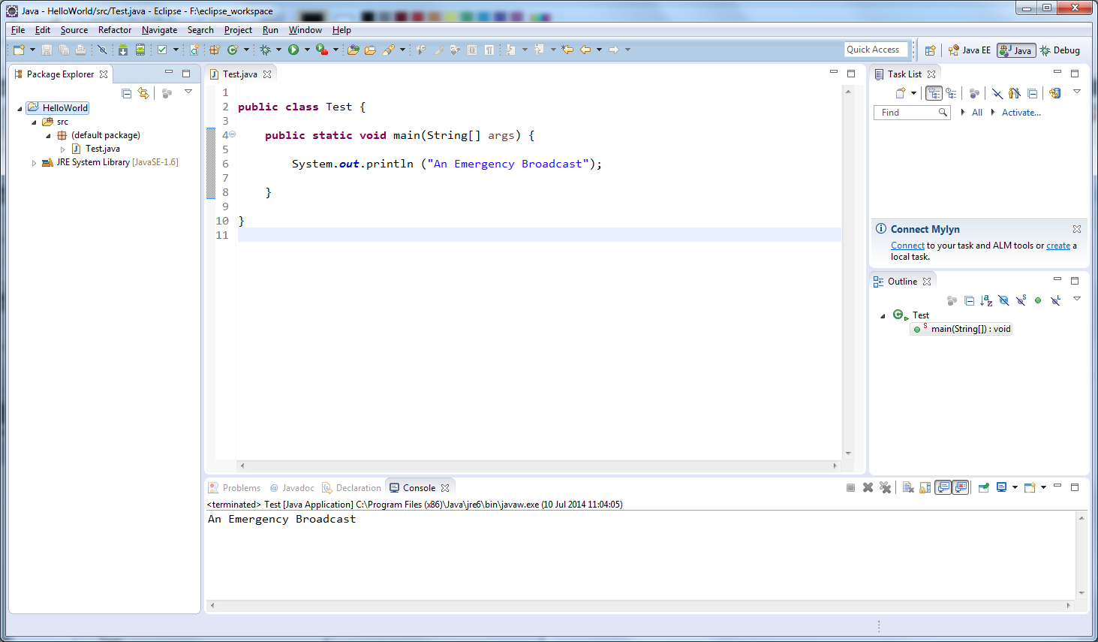
Output placed in the Console view

Slide 16
How did the code compile?
Languages such as Java, C, C++ etc. are “Compiled” prior to execution, i.e. changed into machine executable form.
By default Eclipse auto-compiles any files as soon as they are saved.
It is usually better to leave this switched on during Java development
Turn this on/off by selecting
  Project | Build Automatically

Slide 17
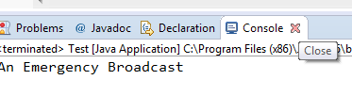
Views and Perspectives
Eclipse is BIG
You need learn how to deal with “views” and “perspectives” which are required to manage such a large application
Views are basically application windows, e.g. The “Navigator Explorer”, the output “Console”
If you ever lose one of your views, open it again via the Window | Show View menu
Try closing the console window by pressing the ‘x’ at the right hand side, then make it reappear using the menu options

Slide 18
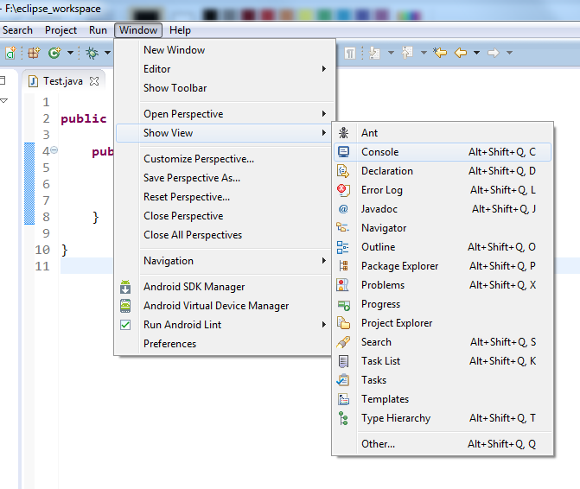
Showing a view

Slide 19
Perspectives
A Perspective is a mechanism that allows a typical set of views to be associated with certain project types
When programming in Java, you will typically only ever use the Java perspective and the Debug perspective
The current perspective is usually shown at the top right hand-side of the editor windows
If you find yourself in the wrong perspective (often after debugging), change it via the Window | Open Perspective menu

Slide 20
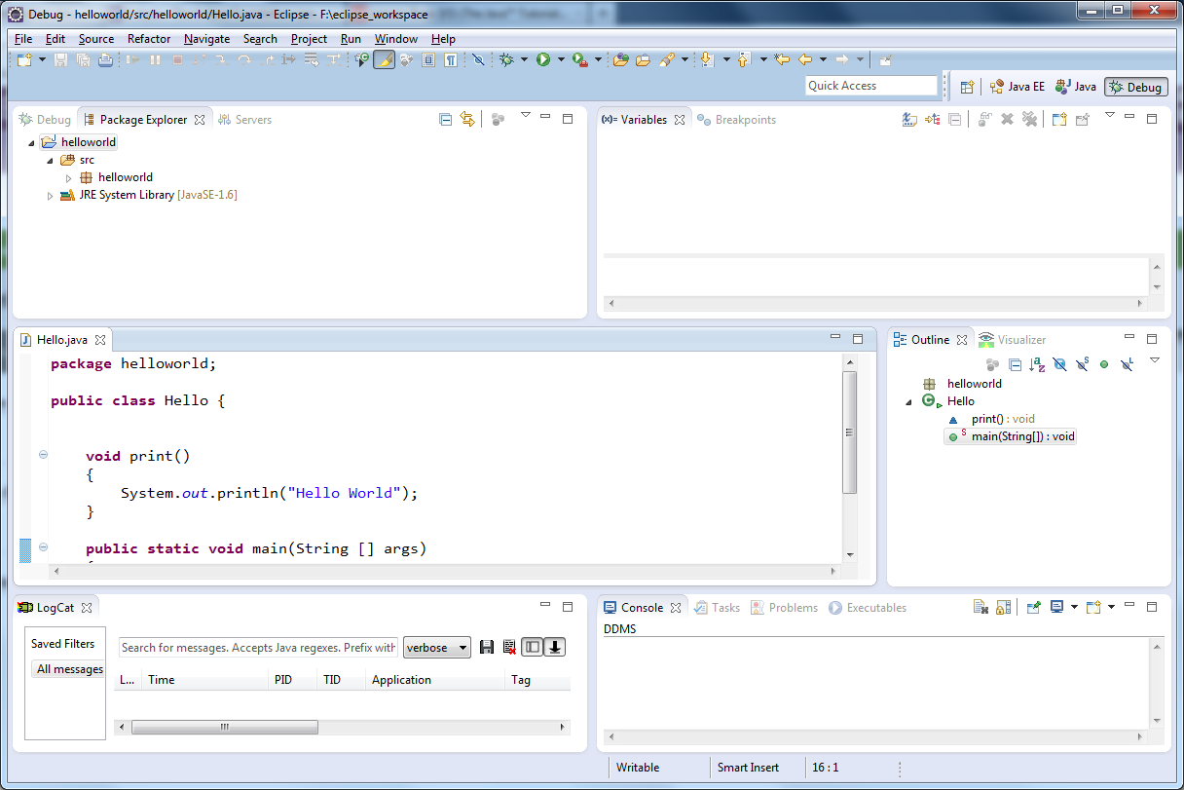
In the debug perspective

Slide 21
Errors and warnings
Because Eclipse is smart, it will inform you about problems prior to compilation.
Errors and warnings are shown as decorations within a border next to the editor
Hovering over the decorator usually pops up more information regarding the problem.
A light bulb means it has idea about how to fix the problem!

Slide 22
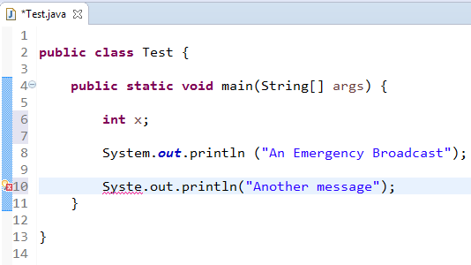

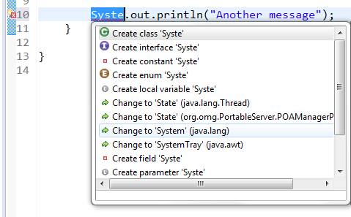
Error shown as red “X”
Hover over ‘X’ to see the error message
Click when a light bulb is shown to see suggested fixes

Slide 23
Using help
It is impossible to develop a modern Java application without access to the help pages
Either place the cursor within a class name and press F1, or switch on Dynamic help using Help | Dynamic help menu
Ensure you have the “Help” view on display
It is better to place this at the bottom of the application stacked with the “Console” view

Slide 24
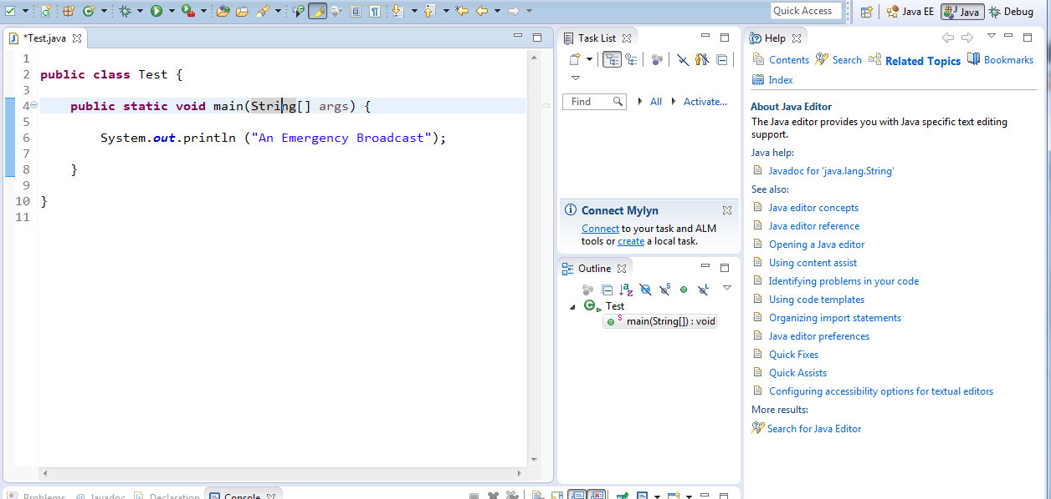
Select “String” then press F1 to see help

Slide 25
Auto completion (ctrl-space)
Eclipse also helps you write your code (if you are too lazy to type)
Auto-completion often works as you type, e.g. if you type System. in the previous example it lists all methods of the associated Hello class
Auto-completion also works by holding down CTRL – SPACE when you need to force it to present “ideas” about code to be written

Slide 26
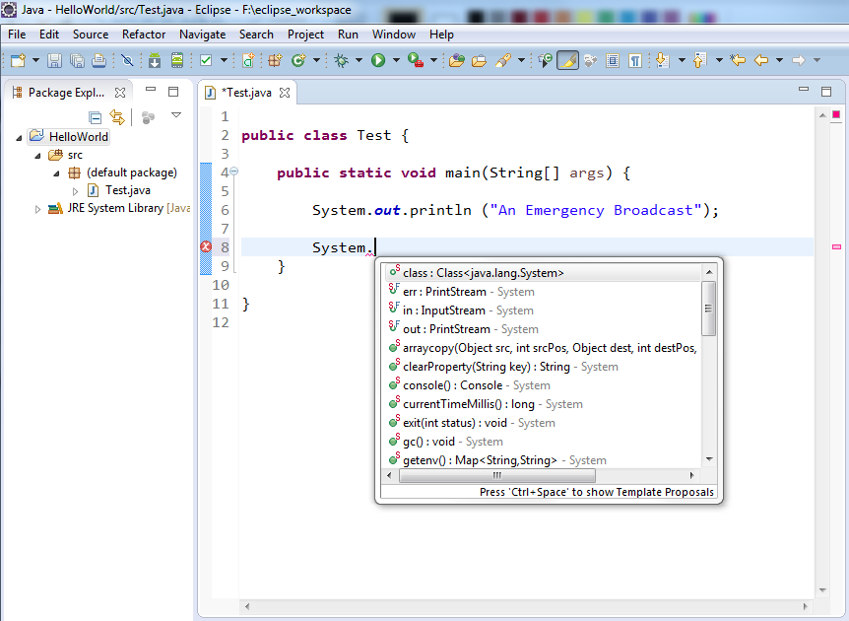

Slide 27
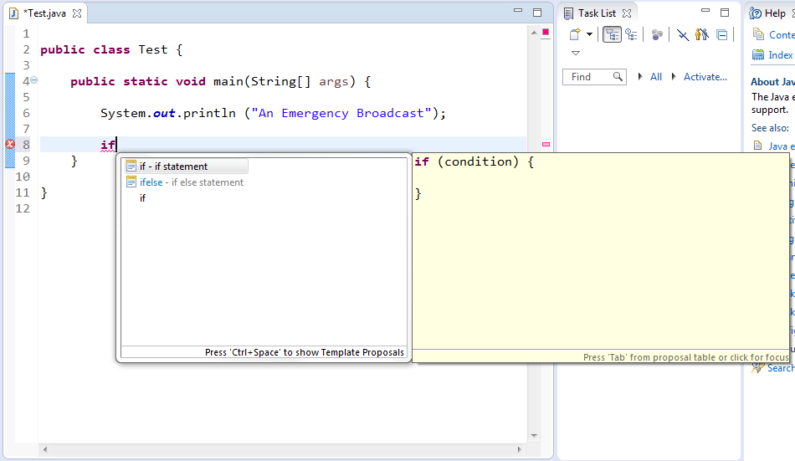
Pressing “CTRL-Space” forces auto-completion to be shown

Slide 28
Using “import”
When writing code, we need to re-use many more pre-written classes
System and String classes are always available, but most classes we use must be “imported”
Import statements are every simple and Eclipse will usually write them for us (using auto-fix).

Slide 29
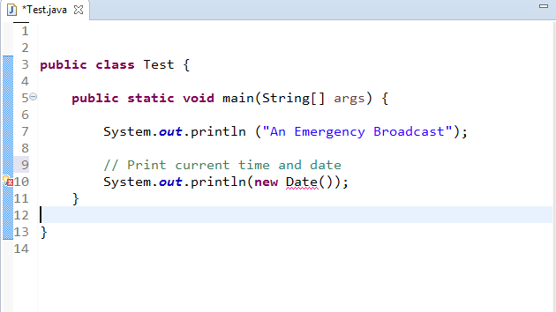
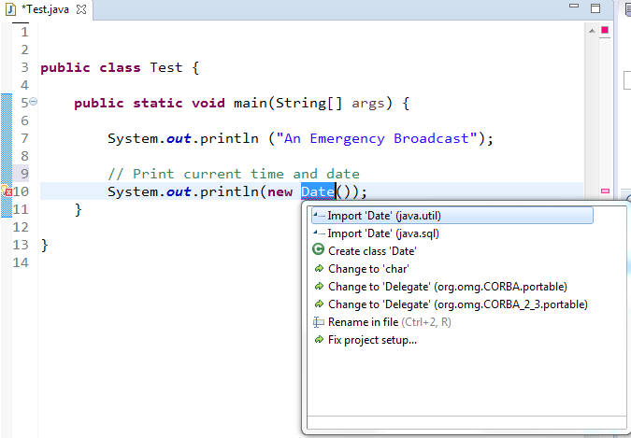
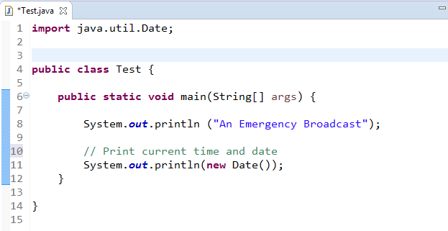
Click to show “fix” options

Slide 30
Debugging
Any real program needs to be debugged at some stage
Eclipse offers excellent debugging support, allowing single stepping, variable value inspection, hot code replace etc.
Learn how to use the debugger early on, practice on basic programs (set break points, single step etc.)
Debug by selecting “Debug As” rather than “Run As”

Slide 31
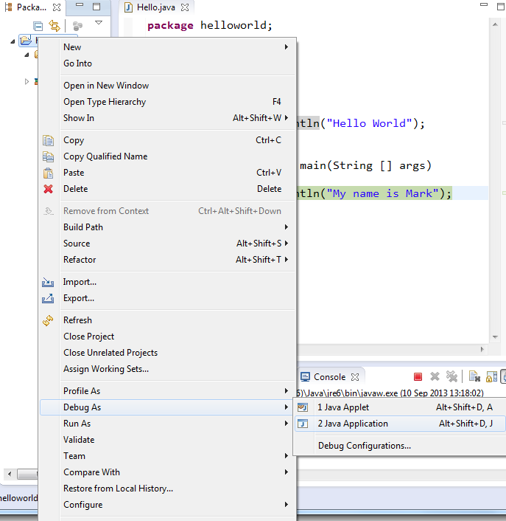
Debugging rather than running

Slide 32
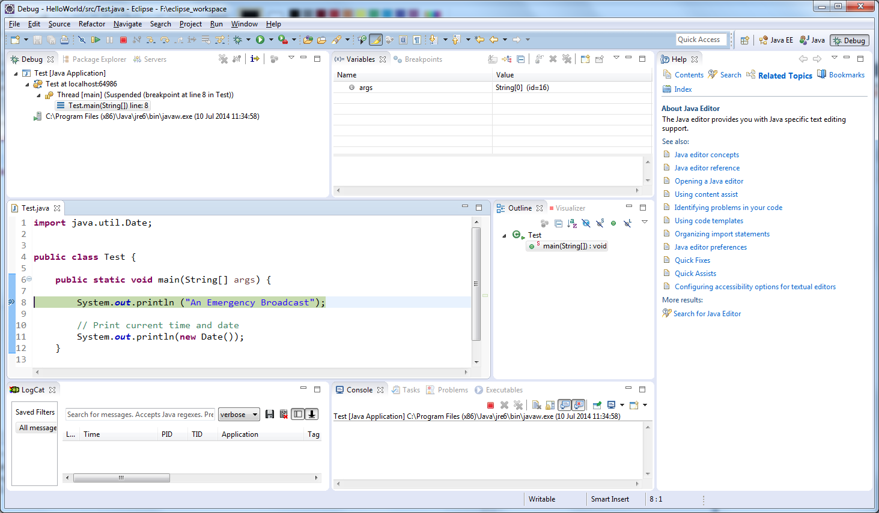
Debug in the “Debug perspective”
Call Stack
Source code
Execution Controls
Variables

Slide 33
Debugging - breakpoints
Breakpoints are used to tell the debugger where to stop during execution
These should be set before debugging is started, otherwise the code will usually just execute as normal
Breakpoints can be added to the code by double clicking in the left hand margin next to a command
Once a breakpoint is “hit” during execution the program is halted and the debugging controls can be used to step through the code one instruction at a time
During debugging it is usually to “single step” through algorithms which are cause problems, and to view the variable values

Slide 34
Debugging controls
Resume Terminate Step Into Step Over
Resume – causes the program to run until the next breakpoint
Terminate – Terminates the program
Step Into – If the command calls other code then attempts to debug that code
Step Over – executes a single command (and never attempts to debug calls to other code).

Slide 35
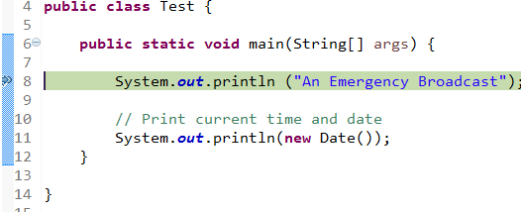
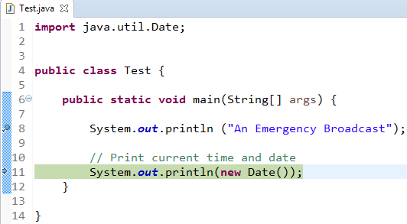
Working example
Step Over selected
Breakpoint
(set/cleared with double click)

Slide 36
Final Tips
Don’t try to deal with files directly on the files system, use the workspace only
If working at home use the same version of Eclipse that we have in the labs (4.5 Mars)
When transferring projects between installations either copy the whole workspace, or use
File | Import | General | Existing Projects
  (to import projects from home etc.)

